Slide 1
Using Machine Learning to find power consumtion regimes of FS building

Slide 2
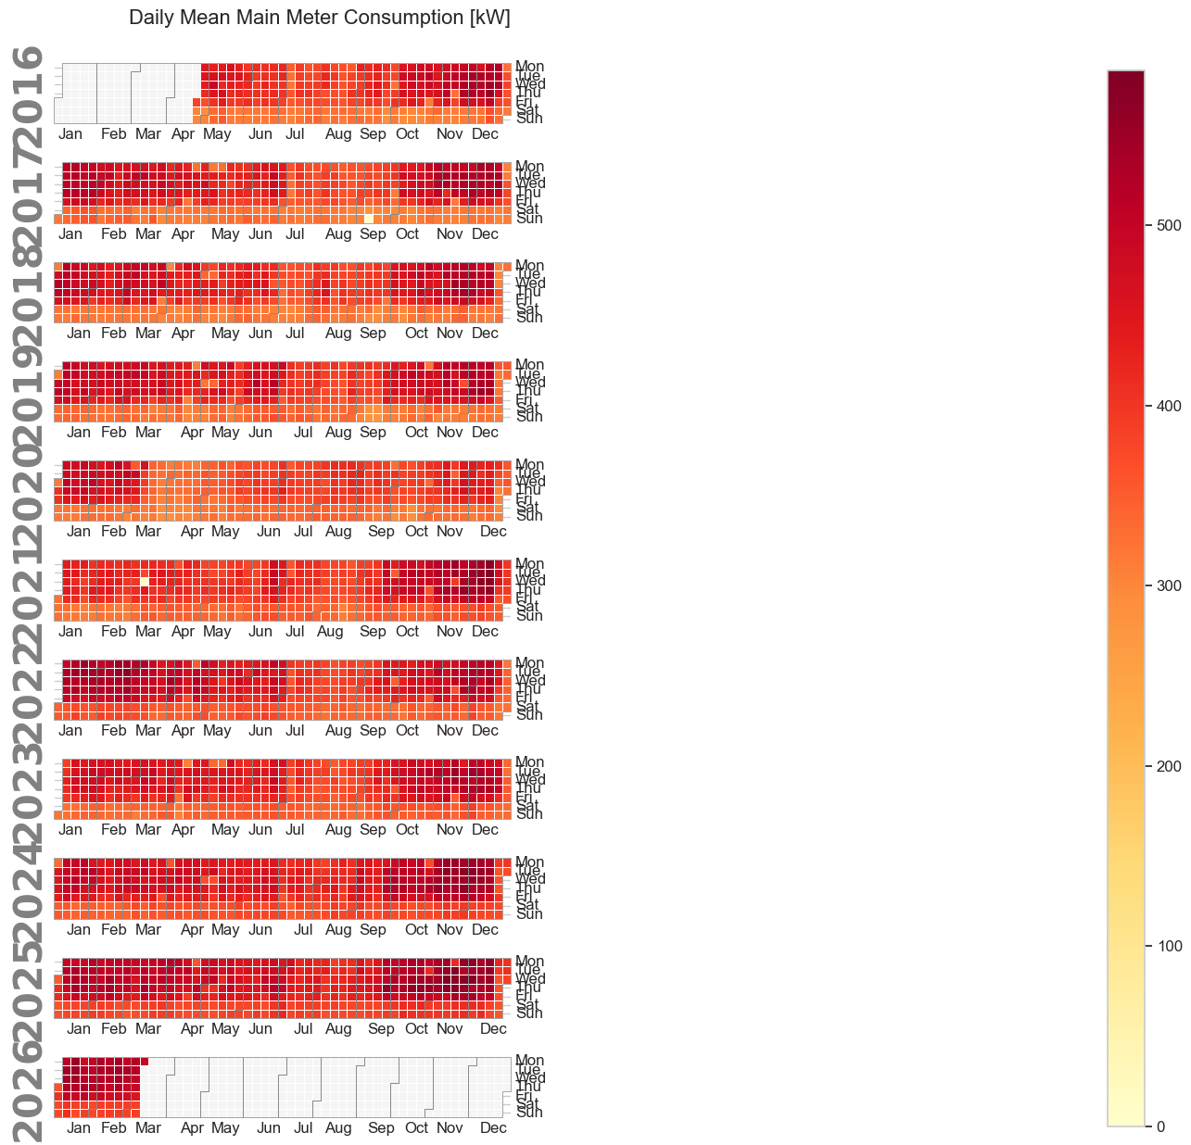
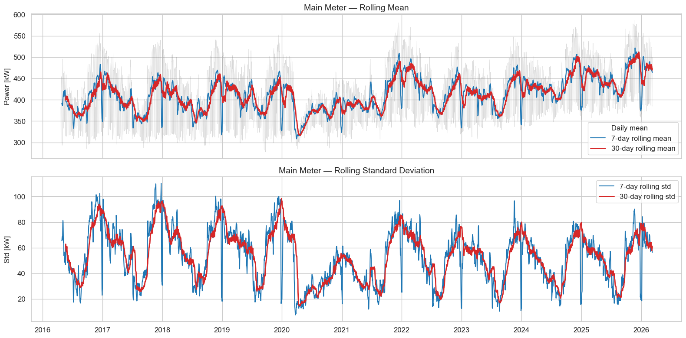
What is the task?
Use existing dataset that contains data from main power meter, hall power meter, hourly outside temperatures, etc
Explore different clustering methods
Try to find regimes of power conusmption like f.e. summer break weekday, holiday during winter semester, etc
Use it for further AutoML approach for modelling the future power consumption

Slide 3
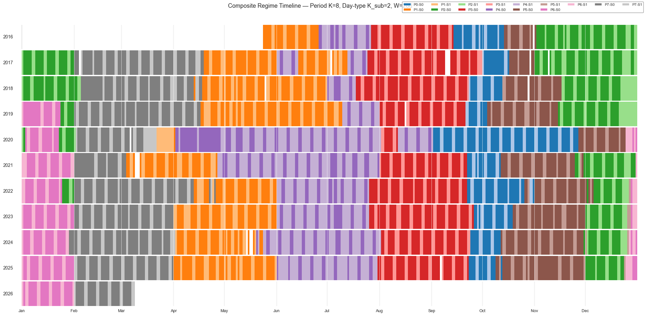
What have I done?
Explored different methods to pre-process data (daily/weekly aggregation, detrending, adding lagged features, adding rolling features, etc
Explored performance of
different clustering models
including K-means,
Gaussian Mixture Mode,
Markov Hidden Model etc.
Now exploring the embedding
of different models with
different cluster scopes

Slide 4
What am I going to do
Find the most appropriate way for clustering.
Use the data to divide timeseries into different regimes, and train models for each
Use clusters for switching the models
Compare the precision of switching with autoML detective methods

